Slide 1
The Retail Challenge
@Mind Over Data
@NOVA IMS
By group F

Slide 2
TABLE OF CONTENTS
01
04
02
05
03
06
ABOUT THE DATASET
PoS CLUSTERS
What we do with the dataset
Point of Sales by Product Preferences
EXPLORATORY DATA ANALYSIS
FORECASTING
Top Products Sales Monthly – 2 Main Sales Patterns
PoS CLUSTERS
FORECASTING
Point of Sale by Value
Top Products Sales Weekly – 2 Main Sales Patterns

Slide 3
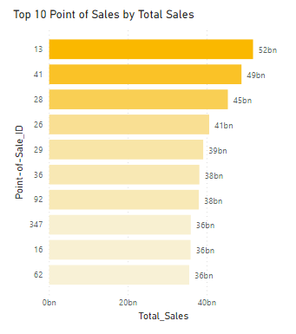
1. ABOUT THE DATASET
198M
Products sold
320bn
Total sales
91171152 rows
9 columns
410 points of sale
2820 products
1523 product brands

Slide 4
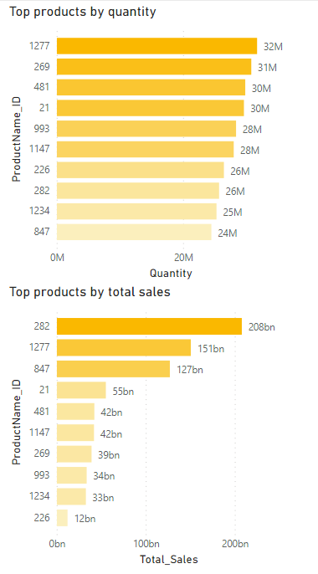
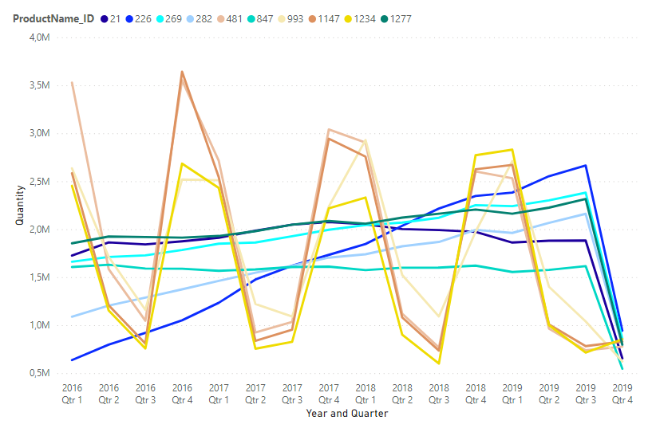
2. DATA EXPLORATORATION
TOP PRODUCTS QUARTERLY TRENDS

Slide 5
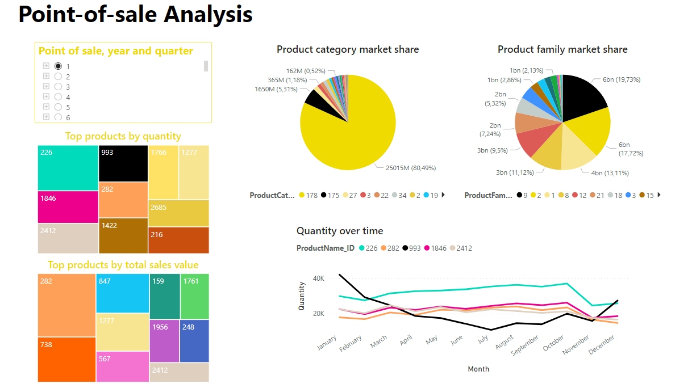
2. DATA EXPLORATORATION
BY POINT OF SALE

Slide 6
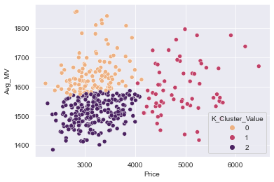
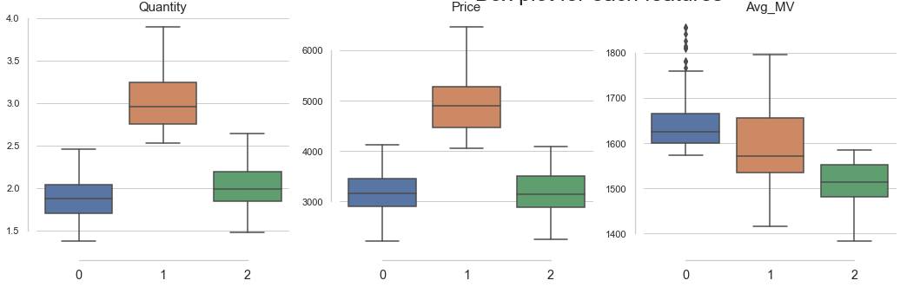
3. POINT-OF-SALE CLUSTERS
By Value
THE BOUTIQUE
THE STANDARD STORE
THE DISCOUNT
Lowest Quantity
Highest Average of Monetary Value
Highest Quantity
Regular Average of Monetary Value
Lowest Average of Monetary Value

Slide 7
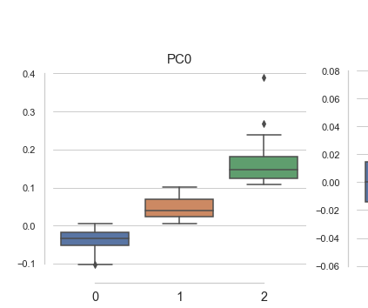
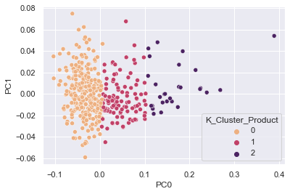
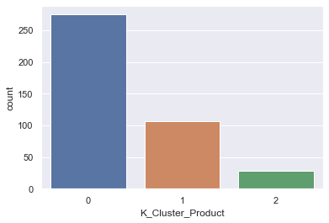
3. POINT-OF-SALE CLUSTERS
By Product Preference
Cluster 1
Cluster 2
Cluster 3
Top Product-Families: 9, 2, 18, 3
Worst Product-Families: 21, 11, 10, 20
Top Product-Families: 15
Worst Product-Families: 12
Top Product-Families: 21, 11, 10, 20
Worst Product-Families: 9, 2, 18, 3, 1

Slide 8
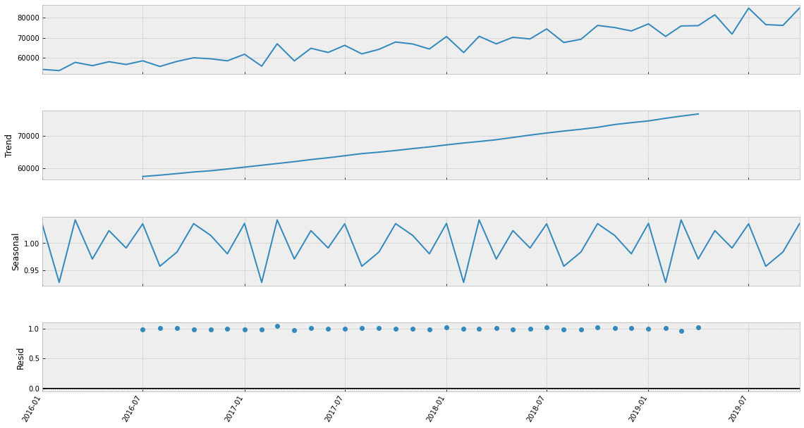
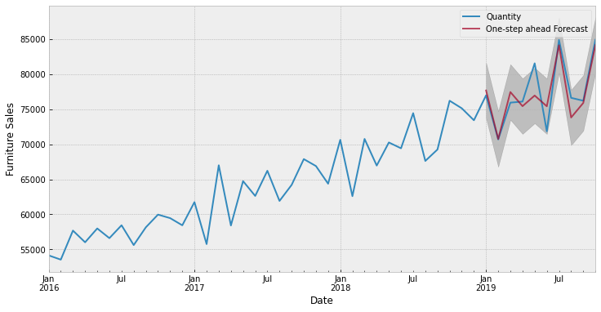
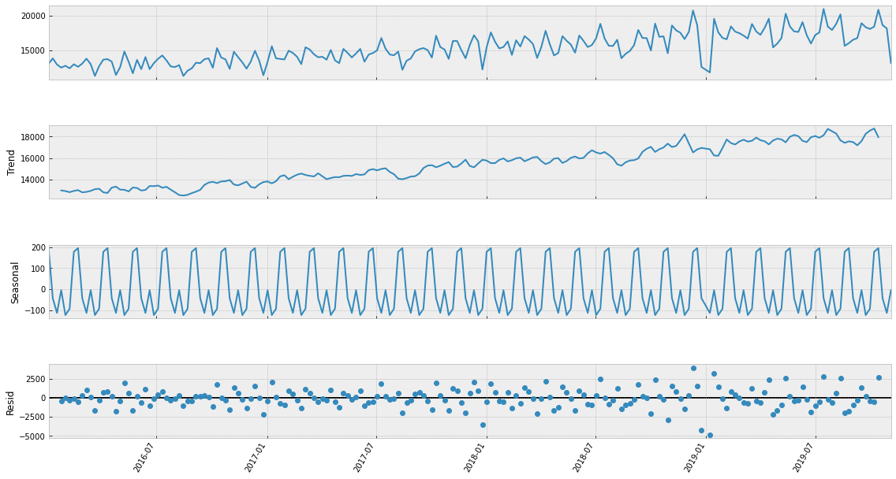
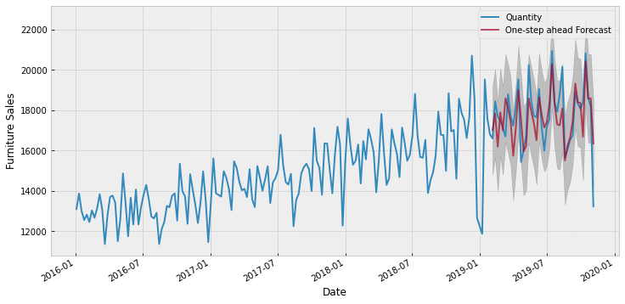
4. FORECASTING
TOP PRODUCTS SALES - UPWARD TREND – PRODUCT ID 2601
Monthly sales quantity
SARIMA(1, 1, 1)x(0, 1, 1, 12) |  | RMSE | MAPE
In-Sample Forecast | T+1 | 2146.52 | 0.0203
Out-of-Sample Forecast | T+1 | 2743.15 | 0.0285
 | T+2 | 2955.68 | 0.0334
 | T+3 | 2792.47 | 0.0316
Weekly sales quantity
SARIMA(0, 1, 1)x(0, 1, 1, 52) |  | RMSE | MAPE
In-Sample Forecast | T+1 | 1046.29 | 0.0451
Out-of-Sample Forecast | T+1 | 831.93 | 0.0335
 | T+2 | 892.30 | 0.0350
 | T+3 | 898.41 | 0.0355
 | T+4 | 877.25 | 0.0326
 | T+5 | 863.11 | 0.0317
 | T+6 | 1177.92 | 0.0467

Slide 9
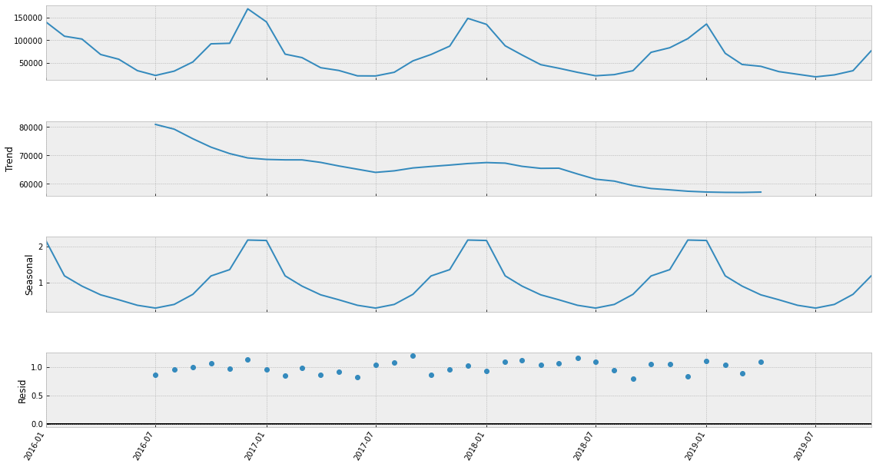
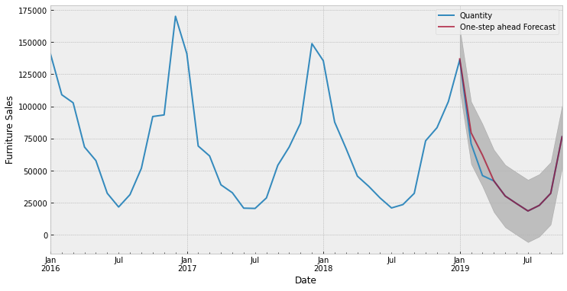
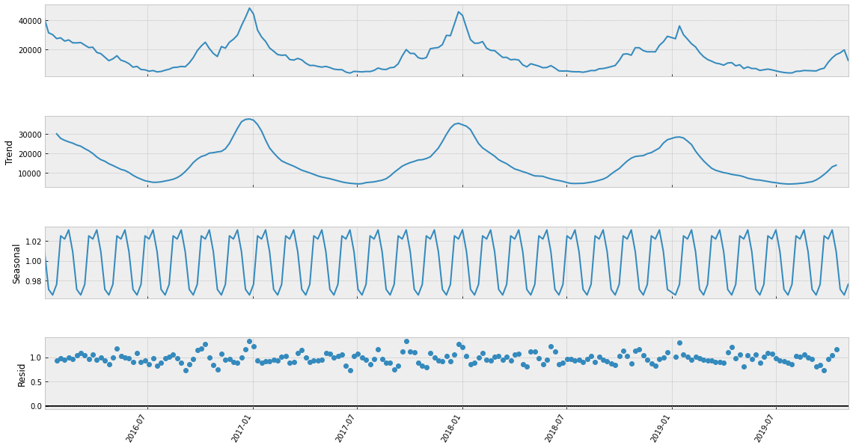
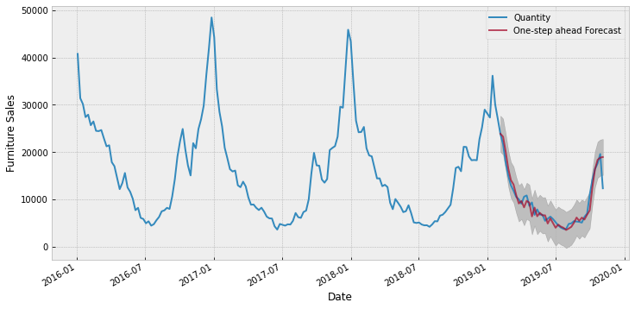
4. FORECASTING
TOP PRODUCTS SALES - SEASONAL TREND – PRODUCT ID 481
Monthly sales quantity
SARIMA(4, 0, 2)x(0, 1, 2, 12) |  | RMSE | MAPE
In-Sample Forecast | T+1 | 5700 | 0.047
Out-of-Sample Forecast | T+1 | 7883.66 | 0.1370
 | T+2 | 8228.25 | 0.1631
 | T+3 | 5840.91 | 0.1108
Weekly sales quantity
SARIMA(2, 1, 0)x(0, 1, 1, 52) |  | RMSE | MAPE
In-Sample Forecast | T+1 | 1589.9 | 0.1218
Out-of-Sample Forecast | T+1 | 1067.62 | 0.1216
 | T+2 | 1634.71 | 0.1760
 | T+3 | 1870.05 | 0.1783
 | T+4 | 1936.145 | 0.1741
 | T+5 | 2057.68 | 0.1834
 | T+6 | 2133.52 | 0.1817

Slide 10
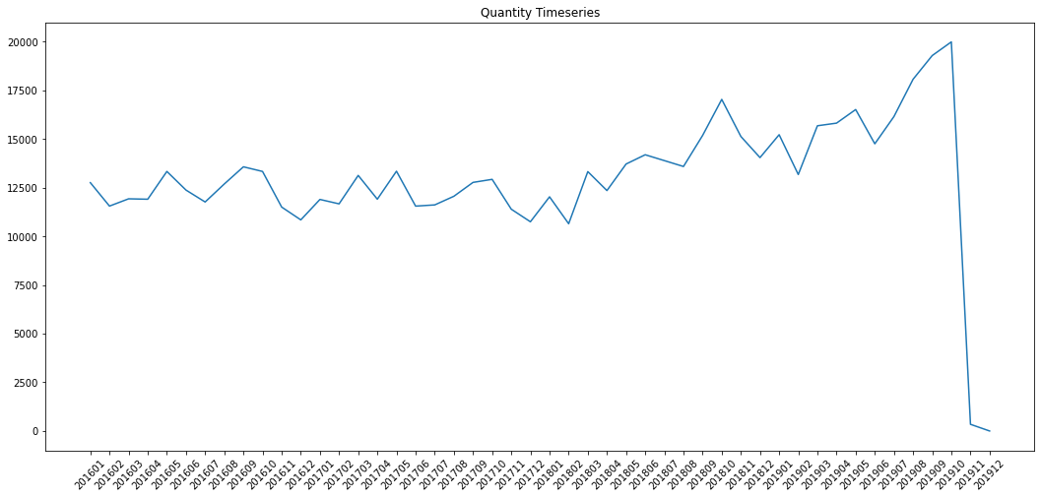
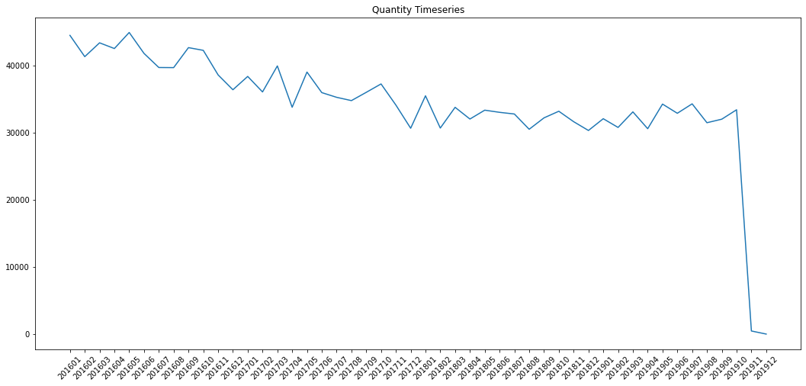
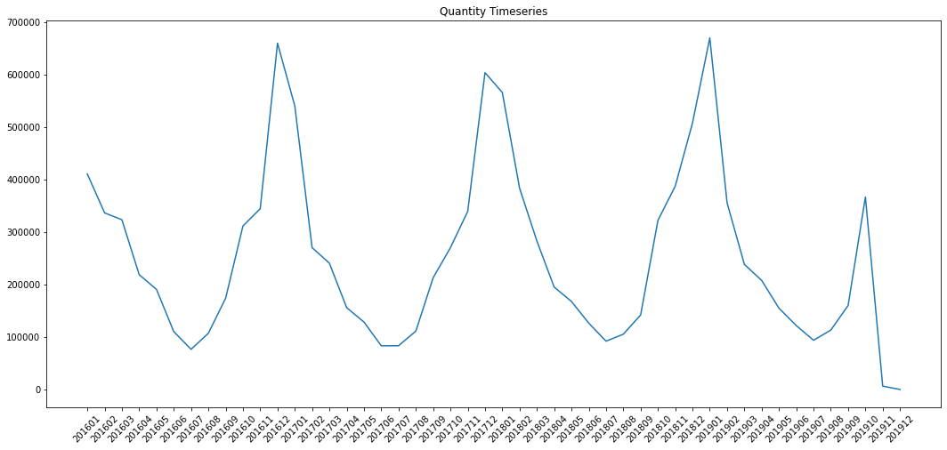
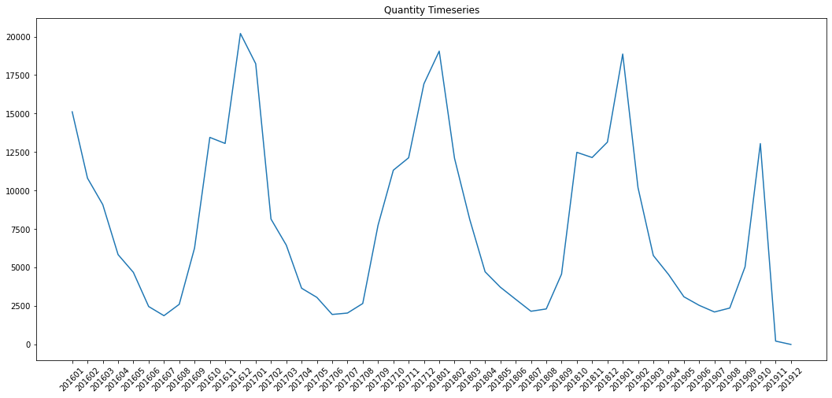
4. PRODUCT FORECASTING SOLUTION
Family Product No-seasonal
1
10
11
12
2
6
7
9
18
21
4
5
Forecast on weekly basis
SARIMA(0, 1, 1)x(0, 1, 1, 52)
Family Product seasonal (increasing quantity in winter or summer)
Forecast on monthly basis
SARIMA(4, 0, 2)x(0, 1, 2, 12)
13
14
15
16
20
17

Slide 11
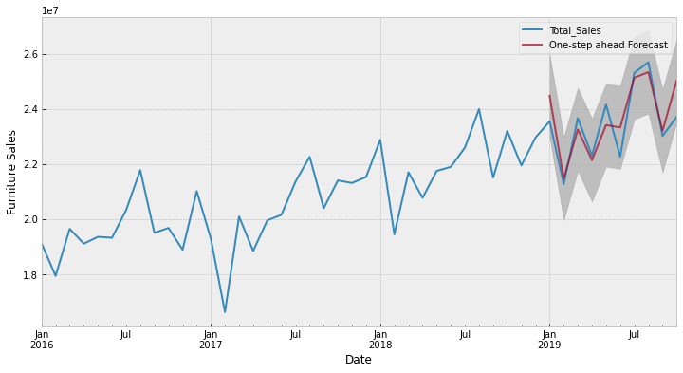
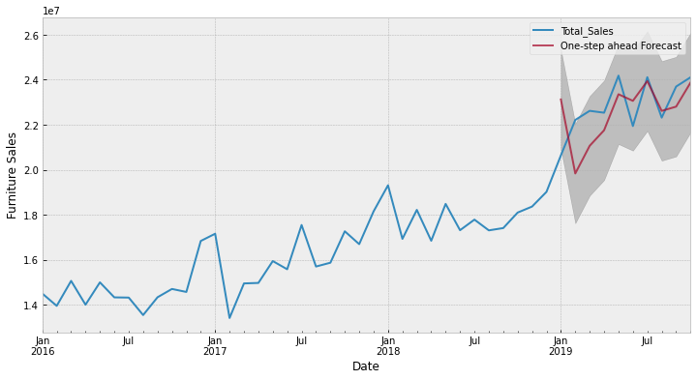
4. FORECASTING
POINT OF SALE REVENUE - MONTHLY
Cluster 1
Point-of-sale 1
SARIMA(0, 1,3)x(0, 1, 1, 12) |  | RMSE | MAPE
In-Sample Forecast | T+1 | 686916.94 | 0.0237
Out-of-Sample Forecast | T+1 | 782189.66 | 0.0293
 | T+2 | 696350.81 | 0.0235
 | T+3 | 808669.95 | 0.0291
Cluster 2
Point-of-sale 19
SARIMA(2, 1, 0)x(1, 1, 1, 12) |  | RMSE | MAPE
In-Sample Forecast | T+1 | 1334018 | 0.0484
Out-of-Sample Forecast | T+1 | 2468038 | 0.0858
 | T+2 | 1950022 | 0.0665
 | T+3 | 1738001 | 0.0525

Slide 12

THANKS!
GROUP F
Lorenzo Pigozzi
Phuc Nguyen
Ema Mandura
Xavier Gonçalves

